Slide 1


Text Processing Commands and Output
Text processing utilities and commands are essential tools for manipulating and analyzing text data in various ways. They are often used in command-line environments and scripting to perform tasks such as searching, extracting, formatting, and transforming text.
A
by Abhilash Jadala

Slide 2
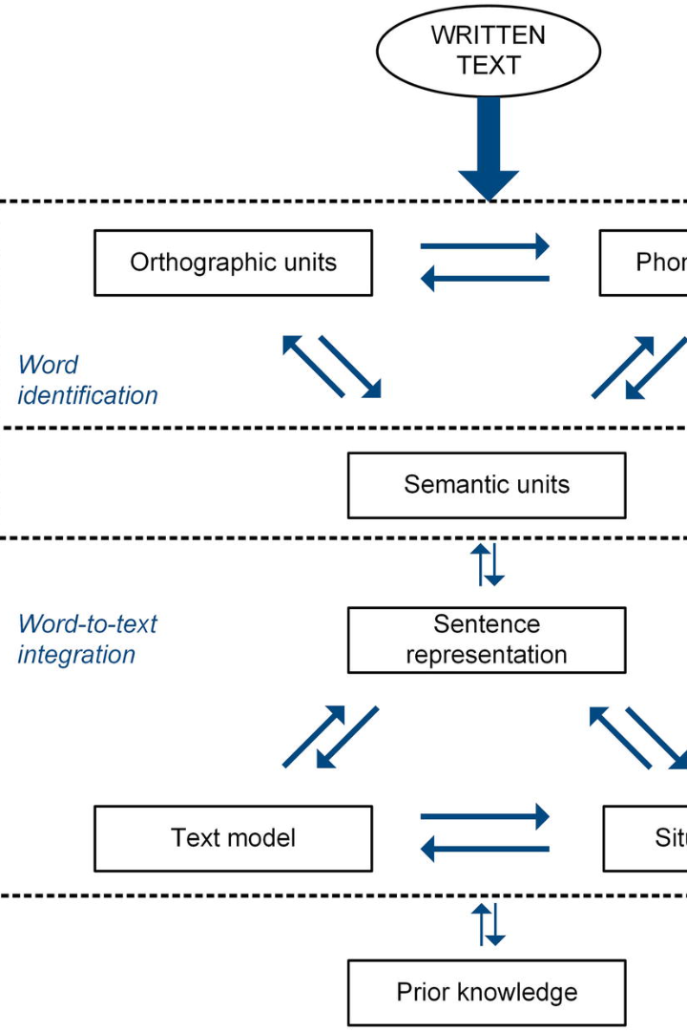
Introduction to Text Processing Commands
1
What are text processing commands?
2
Why are they important?
Understand the relevance of text processing commands in automating tasks and extracting valuable information.
Learn what text processing commands are and how they can be used to manipulate and analyze text data.
3
Key concepts to know
Get familiar with important concepts such as pipes, redirection, and regular expressions.

Slide 3
Commonly Used Command Line Tools
grep
sed
Search for specific patterns in files and extract matching lines.
Edit and transform text by substituting, deleting, or appending specific patterns.
$ grep "pattern" file.txt This line contains the pattern.
sed [OPTIONS] 'script' input_file
awk
cut
Analyze and manipulate structured text data using patterns and actions.
Extract specific fields or columns from files or output.
Command: awk '/pattern/ {print $2}' file
Command: cut -f 2 -d ',' file
Output: The second field (column) of a CSV file, using a comma (,) as the delimiter.
Output: The second column of lines in "file" that match the "pattern."
Conclusion: Great for isolating columns of interest in delimited text files.
Conclusion: Ideal for extracting specific fields or columns from structured data.

Slide 4
Commonly Used Command Line Tools
1
paste
Command: paste file1 file2
Output: Merges lines from "file1" and "file2" side by side.
Conclusion: Useful for combining data from multiple sources.
2
wc:
Command: wc -l file
Output: The number of lines in "file."
Conclusion: Useful for getting a quick count of lines in a file
3
grep and xargs:
Command: grep -l pattern * | xargs rm
Output: Deletes files that contain the specified "pattern" in their content.
Conclusion: Handy for bulk file deletion based on a search pattern.

Slide 5
Outputting Results to the Command Line
1
stdout
Learn how to display the results of text processing commands directly on the command line.
2
stderr
Understand how to handle error messages and display them separately from the standard output.
3
Formatting output
Explore techniques to format and customize the presentation of text processing command results.

Slide 6
Redirecting Output to a File
1
Redirecting stdout
Learn how to save the output of text processing commands to a file for later use.
Appending to a file
2
Discover how to append new output to an existing file without overwriting the previous content.
3
Redirecting stderr
Explore methods to redirect error messages to a file instead of displaying them on the command line.

Slide 7

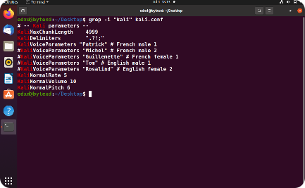
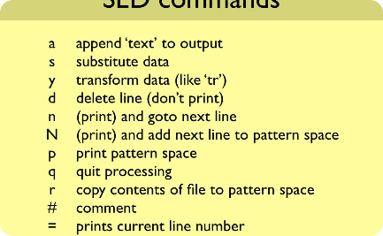
Sorting and Filtering Text
Sort command
Grep command
Sed command
Discover how to sort text data alphabetically or numerically based on columns or fields.
Find specific patterns and lines in files based on regular expressions.
Filter and transform text by substituting, deleting, or editing specific patterns or lines.

Slide 8

Regular Expressions for Text Processing
1
Basics of regex
2
Common regex metacharacters
Learn the fundamentals of regular expressions to search and manipulate text patterns.
Discover commonly used metacharacters and their meanings in regular expressions.
3
Practical examples
Explore real-world scenarios where regular expressions are used for advanced text processing.

Slide 9
Examples of Practical Applications and Use Cases
Data extraction
Data cleaning
Automating tasks
Learn how to extract specific information from log files and system outputs using text processing commands.
Discover techniques to clean and transform messy and inconsistent text data for analysis and visualization.
Explore ways to automate repetitive tasks by creating scripts using text processing commands.

Slide 10

Conclusion:
These are just a few examples of text processing commands and their typical use cases. The choice of command and its output depend on the specific text manipulation or analysis task you need to perform. Mastering these tools can greatly enhance your ability to work with text data efficiently.

